Slide 1

Web Development & Design Foundations with HTML5
Tenth Edition
Chapter 1
Introduction to the Internet and World Wide Web
Copyright © 2021, 2019, 2017 Pearson Education, Inc. All Rights Reserved

Slide 2
Learning Outcomes (1 of 2)
In this chapter, you will learn how to
Describe the evolution of the Internet and the Web
Explain the need for web standards
Describe Universal Design
Identify benefits of accessible web design
Identify reliable resources of information on the Web
Identify ethical use of the Web
Describe the purpose of web browsers and web servers

Slide 3
Learning Outcomes (2 of 2)
Identify networking protocols
Define URIs and domain names
Describe HTML, XHTML, and HTML5

Slide 4
Internet
The interconnected network of computer networks that spans the globe.

Slide 5
Reasons for Internet Growth in the 1990s
Removal of the ban on commercial activity
Development of the World Wide Web by Tim Berners-Lee at CERN
Development of Mosaic, the first graphics-based web browser at NCSA
Personal computers were increasingly available and affordable
Online service providers offered low-cost connections to the Internet

Slide 6
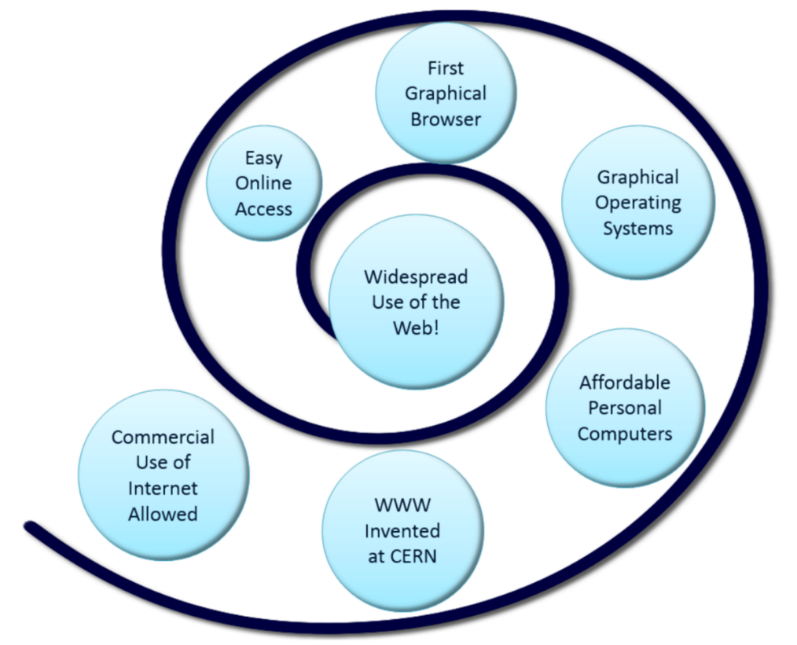
Figure 1.1 Convergence of Technologies

Slide 7
The World Wide Web
The graphical user interface to information stored on computers running web servers connected to the Internet.

Slide 8
Internet Standards & Coordination (1 of 2)
IETF – Internet Engineering Task Force
The principal body engaged in the development of new Internet protocol standard specifications.
RFC – Requests for Comments A formal document from the IETF that is drafted by a committee and subsequently reviewed by interested parties
IAB – Internet Architecture Board Provides guidance and broad direction to the IETF. Responsible for publications for RFCs.

Slide 9
Internet Standards & Coordination (2 of 2)
ICANN - The Internet Corporation for Assigned Numbers & Names
Non-profit organization
Main function is to coordinate the assignment of:
Internet domain names
IP address numbers
Protocol parameters
Protocol port numbers.

Slide 10
Growth of the Internet
Year | Percentage of Global Population Using the Internet
1995 | 0.4%
2000 | 5.8%
2005 | 15.7%
2010 | 28.10%
2015 | 45%
2018 | 55.1%
2019 | 56.1%
Source: http://www.internetworldstats.com/emarketing.htm

Slide 11
Intranet & Extranets
Intranet
A private network contained within an organization or business used to share information and resources among coworkers.
Extranet
A private network that securely shares part of an organization’s information or operations with external partners

Slide 12
Web Standards and the W3C Consortium
W3C – World Wide Web Consortium
Develops recommendations and prototype technologies related to the Web
Produces specifications, called Recommendations, in an effort to standardize web technologies
WAI – Web Accessibility Initiative

Slide 13
Web Accessibility
Accessible Website
provides accommodations for individuals with visual, auditory, physical, and neurological disabilities
WAI
W3C’s Web Accessibility Initiative http://www.w3.org/WAI
WCAG 2.1
Web Content Accessibility Guidelines http://www.w3.org/WAI/WCAG20/quickref/

Slide 14
Web Accessibility & The Law
Americans with Disabilities Act (ADA)
Prohibits discrimination against people with disabilities
Section 508 of the Rehabilitation Act
Requires that government agencies must give individuals with disabilities access to information technology that is comparable to the access available to others
http://www.section508.gov

Slide 15
Universal Design for the Web
Universal Design
strategy for making products, environments, operational systems, and services welcoming and usable to the most diverse range of people possible
https://www.dol.gov/odep/topics/UniversalDesign.htm

Slide 16
Figure 1.2 A smooth ride is a benefit of universal design

Slide 17
Reliability & Information on the Web
Questions to Ask:
Is the organization credible?
How recent is the information?
Are there links to additional resources?
Is it Wikipedia? If so, further research is needed.

Slide 18
Checkpoint 1.1
Describe the difference between the Internet and the Web.
Explain three events that contributed to the commercialization and exponential growth of the Internet.
Is the concept of universal design important to web developers? Explain your answer.

Slide 19
Network Overview
Network two or more computers connected together for the purpose of communicating and sharing resources

Slide 20
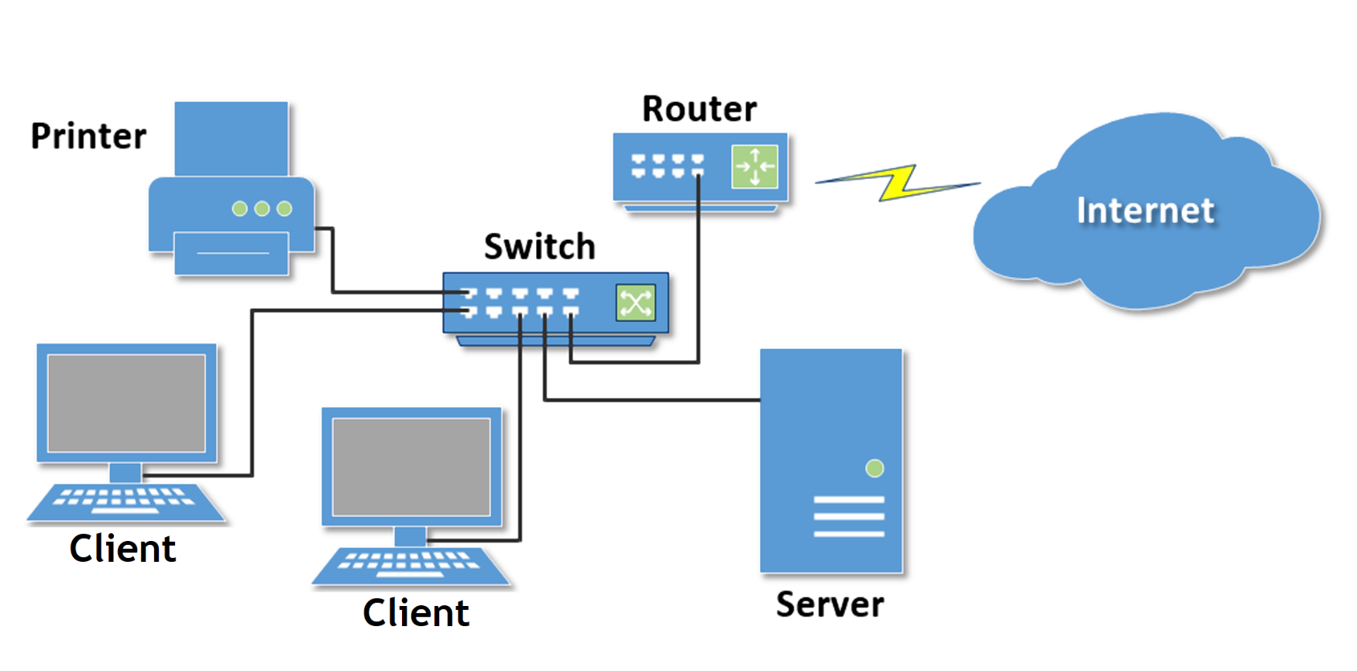
Figure 1.4 Common components of a network

Slide 21
Networks
LAN – Local Area Network
Usually confined to a single building or group of buildings
WAN – Wide Area Network
Usually uses some form of public or commercial communications network to connect computers is widely dispersed geographical areas.

Slide 22
Internet Infrastructure
Internet Backbone A high capacity communication link that carries data gathered from smaller links that interconnect with it.
Maps of the Internet Backbone
http://www.google.com/search?q=global+internet+backbone+map+images

Slide 23
The Client/Server Model
Client/Server can describe a relationship between two computer programs–the “client” and the “server”.
Client
requests some type of service (such as a file or database access) from the server.
Server
fulfills the request and transmits the results to the client over a network

Slide 24

Client – Web Browser Server – Web Server
Figure 1.5 Web client and web server

Slide 25
Web Client
Connected to the Internet when needed
Usually runs web browser (client) software (such as Microsoft Edge or Google Chrome)
Uses HTTP (Hypertext Transfer Protocol) or HTTPS
Requests web pages from server
Receives web pages and files from server

Slide 26
Web Server
Continually connected to the Internet
Runs web server software (such as Apache or Internet Information Server)
Uses HTTP (Hypertext Transfer Protocol) or HTTPS
Receives request for the web page
Responds to request and transmits status code, web page, and associated files

Slide 27
MIME Type
Multi-Purpose Internet Mail Extension
a set of rules that allow multimedia documents to be exchanged among many different computer systems

Slide 28
Internet Protocols
Protocols
Rules that describe the methods used for clients and servers to communicate with each other over a network.
There is no single protocol that makes the Internet and Web work.
A number of protocols with specific functions are needed.

Slide 29
FTP File Transfer Protocol
A set of rules that allow files to be exchanged between computers on the Internet.
Web developers commonly use FTP to transfer web page files from their computers to web servers.
FTP is also used to download programs and files from other servers to individual computers.

Slide 30
E-mail Protocols
Sending E-mail
SMTP Simple Mail Transfer Protocol
Receiving E-mail
POP (POP3) Post Office Protocol
IMAP Internet Mail Access Protocol

Slide 31

HTTP - Hypertext Transfer Protocol
A set of rules for exchanging files such as text, graphic images, sound, video, and other multimedia files on the Web.
Web browsers send HTTP requests for web pages and their associated files.
Web servers send HTTP responses and the requested files back to the web browsers.
HTTPS – Hypertext Transfer Protocol Secure
Combines HTTP with a security and encryption protocol

Slide 32
TCP/IP Transmission Control Protocol/ Internet Protocol
TCP/IP has been adopted as the official communication protocol of the Internet.
TCP and IP have different functions that work together to ensure reliable communication over the Internet.

Slide 33
TCP Transmission Control Protocol
Purpose is to ensure the integrity of communication
Breaks files and messages into individual units called packets

Slide 34
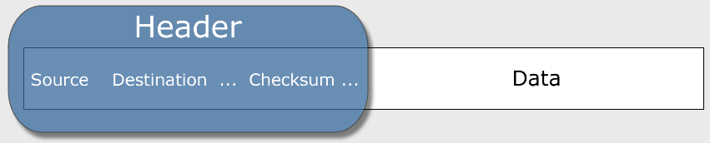
Figure 1.6 TCP packet

Slide 35
IP Internet Protocol
A set of rules that controls how data is sent between computers on the Internet.
IP routes a packet to the correct destination address.
The packet gets successively forwarded to the next closest router (a hardware device designed to move network traffic) until it reaches its destination.
http://www.monitis.com/traceroute/

Slide 36
IP Address
Each device connected to the Internet has a unique numeric IP address.
These addresses consist of a set of four groups of numbers, called octets. For example, 216.58.194.46
An IP address may correspond to a domain name.

Slide 37
Domain Name
Locates an organization or other entity on the Internet
Domain Name System
Divides the Internet into logical groups and understandable names
Associates unique computer IP Addresses with the text-based domain names you type into a web browser
Browser: http://google.com
IP Address: 142.250.81.196

Slide 38
Uniform Resource Identifier
URI – Uniform Resource Identifier
identifies a resource on the Internet
URL – Uniform Resource Locator
a type of URI which represents the network location of a resource such as a web page, a graphic file, or an MP3 file.

Slide 39
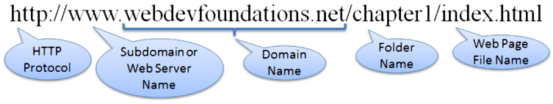
Figure 1.8 URL Describing a file within a folder

Slide 40
TLD Top-Level Domain Name
A top-level domain (TLD) identifies the right-most part of the domain name.
Examples of generic TLDs: .com, .org, .net, .mil, .gov, .edu, .int, .aero, .asia, .cat, .jobs, .name, .biz, .museum, .info, .coop, .post, .pro, .tel, .travel

Slide 41
County Code TLDs
Two character codes originally intended to indicate the geographical location (country) of the web site.
In practice, it is fairly easy to obtain a domain name with a country code TLD that is not local to the registrant.
Examples:
.tv, .ws, .au, .jp, .uk
See http://www.iana.org/cctld/cctld-whois.htm

Slide 42
Domain Name System
The Domain Name System (DNS) associates Domain Names with IP addresses.

Slide 43
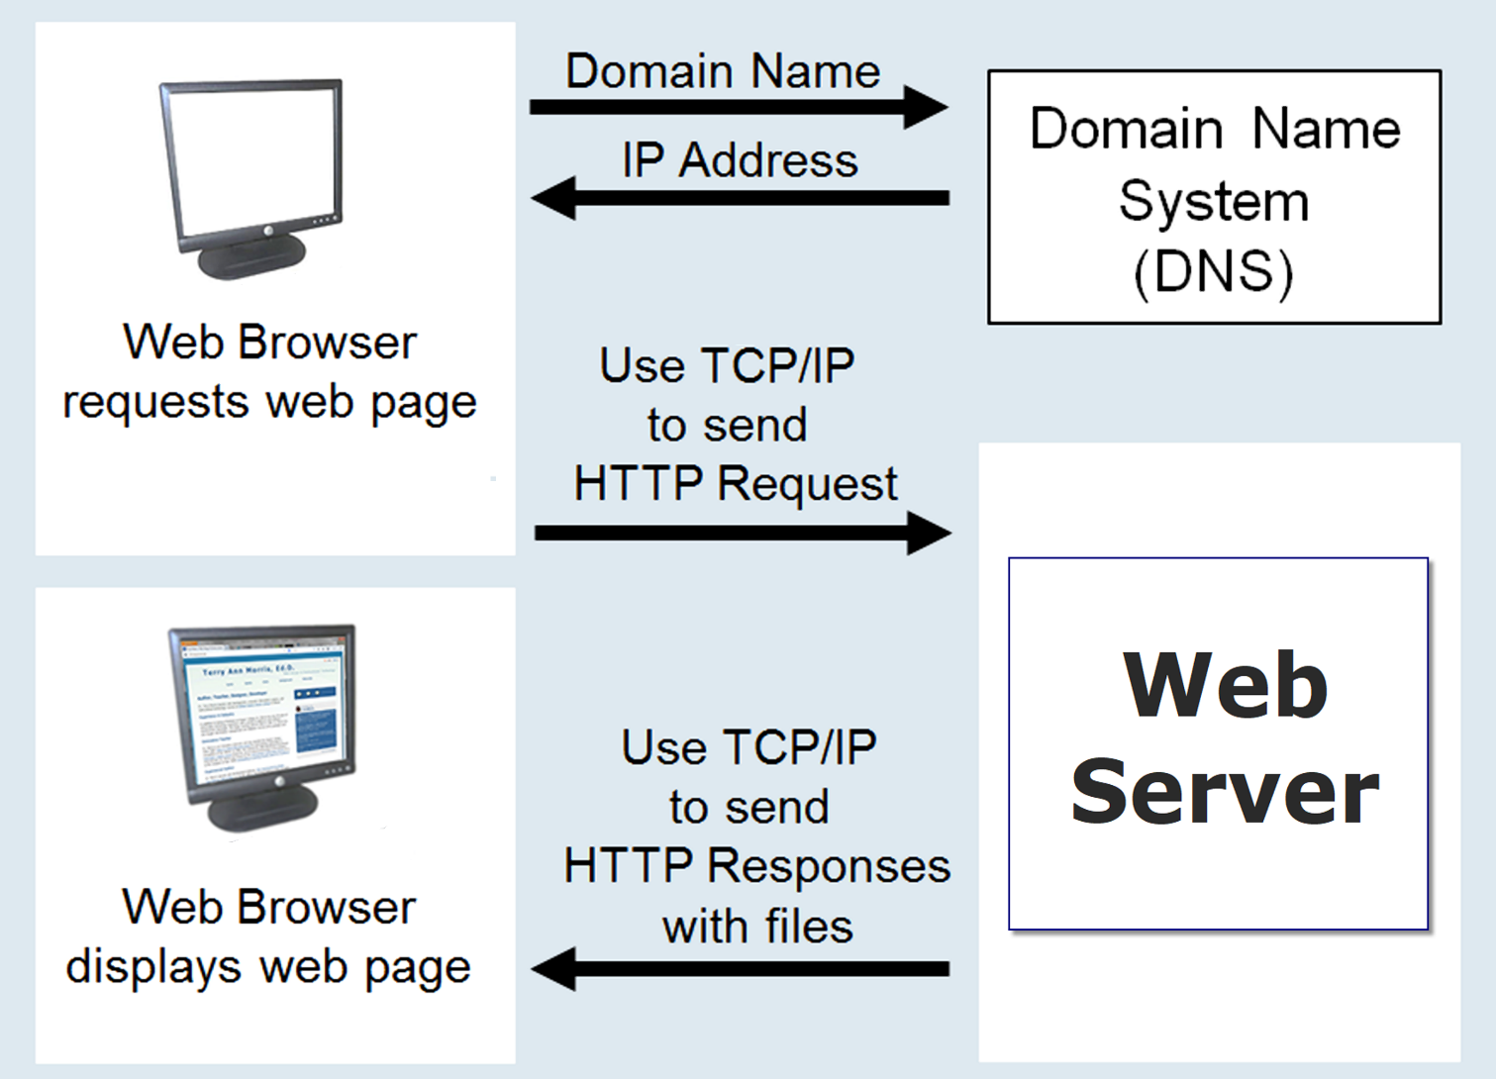
Figure 1.9 Accessing a web page

Slide 44
Markup Languages
SGML – Standard Generalized Markup Language
A standard for specifying a markup language or tag set
HTML – Hypertext Markup Language
The set of markup symbols or codes placed in a file intended for display on a web browser.

Slide 45
Markup Languages (2)
XML–eXtensible Markup Language
A text-based language designed to describe, deliver, and exchange structured information.
It is not intended to replace HTML – it is intended to extend the power of HTML by separating data from presentation.
Notes:
XML is the Extensible Markup Language, which provides rules for creating, structuring, and encoding documents. You often see XML being used to store data and to allow for communication between applications.

Slide 46
Markup Languages (3)
XHTML–eXtensible Hypertext Markup Language
Developed by the W3C as the reformulation of HTML 4.0 as an application of XML.
It combines the formatting strengths of HTML 4.0 and the data structure and extensibility strengths of XML.
Notes:
XHTML is an XML-based HTML. It serves the same function as HTML, but with the same rules as XML documents. These rules deal with the structure of the markup.

Slide 47
Markup Languages (4)
HTML 5
The next version of HTML4 and XHTML
https://www.w3.org/TR/html5/
It’s already been updated!
HTML 5.1
https://www.w3.org/TR/html51/
HTML 5.2
https://www.w3.org/TR/html52/

Slide 48
Checkpoint 1.2
Describe the components of the client/server model as applied to the Internet.
Identify two protocols used on the Internet to convey information that use the Internet but do not use the Web.
Explain the similarities and differences between a URL and a domain name.

Slide 49
Popular Uses of the Internet
E-Commerce
Mobile Access
Blogs
Wikis
Social Networking
RSS
Podcasts
Cloud Computing

Slide 50
Summary
This chapter provided a brief overview of Internet, Web, and introductory networking concepts.

Slide 51
Reading
Read Chapter 1 (lecture slides is NOT enough)
From the end of chapter 1, do the following:
Review Questions (10th ed. page 20-21)

